Slide 1
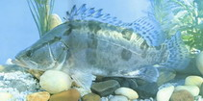
Term paper presentation
1711303 胡婉晴

Slide 2
Taxonomy
Kingdom Animalia
Phylum Chordata
Subphylum Vertebrata
Superclass Actinopterygii
Class Teleostei
Superorder Acanthopterygii
Order Perciformes
Family Percichthyidae
Genus Siniperca Gill ,1862
Species Siniperca chuatsi (Basilewsky, 1855)

Slide 3
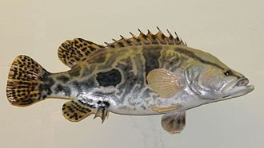
Mandarin fish - Siniperca chuatsi (Basilewsky, 1855)
The Mandarin fish has big mouth, upper jaw extend trailing edge of eye, high body, side flat, backside with ridges, anomalistic macula and dark spots on the side, and has 4-5 dark horizontal stripes near the base of dorsal fin. In addition, it`s yellow, green or brown on its back. It has one lateral line and 121-128 small round scales on the line.

Slide 4
The Mandarin fish are also called Chinese Perch, native to the Amur and Yangtze river basins in China and Russia.They are carnivorous, demersal piscivores which have very specialized feeding habits--as soon as they start feeding, they feed solely on fry of other fish species, almost begin at four-five days old.
Typical of stalking predators, they rely on vision for following the movement of prey before leaping forward and snapping at the victim.
The Mandarin fish dwell in large lakes and river systems, perferring clean water and to hide amongst the stones, tree roots and densely grown aquatic grasses at the bottom. Females mature in two years, while males take only one year. Mandarin eggs are semi-pelagic in flowing water, but sink in stagnant water.

Slide 5
Mandarin fish has a rapid growth rate than other species of Percichthyidae, but growth is highly related to food sufficiency, temperature and stocking density. And that is why it becomes the mainly farmed species in China as a commercial fish.

Slide 6
WHY??
This species has a prominent character which helping them distinguish from other species is that they will not take static aquatic animals, even if they are immediately adjacent, but as soon as the targets begin to move, they swiftly catch them without hesitation.

Slide 7
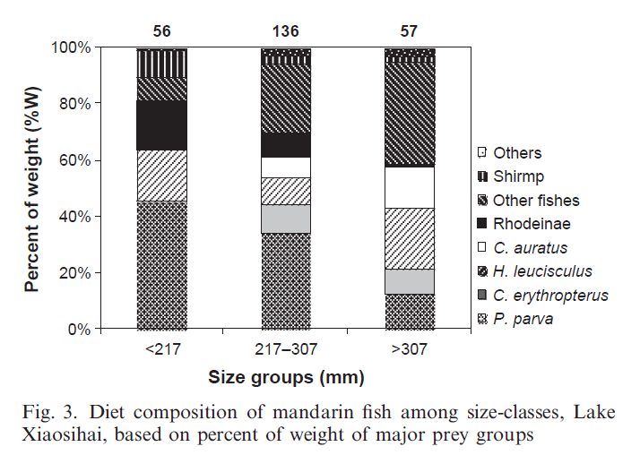
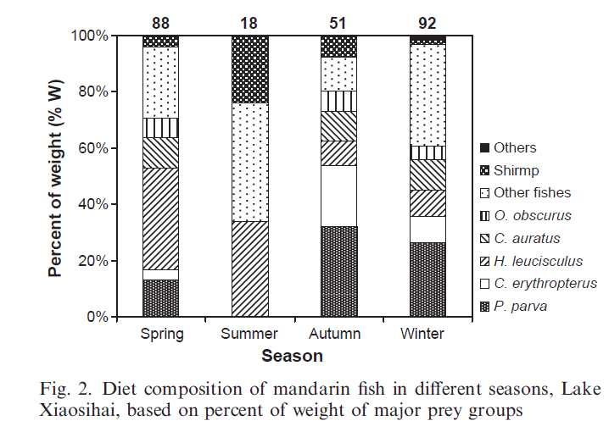
The diet and predator-prey
size relationships were studied
through stomach content analysis.
The diet was featured with significant seasonal and ontogenetic differences.
W. Li1,2;T. Zhang1,*;S. Ye1;J. Liu1;Z. Li1 Feeding habits and predator-prey size relationships of mandarin fish Siniperca chuatsi (Basilewsky) in a shallow lake, central China Journal of Applied Ichthyology.2013;29(1):56-63

Slide 8
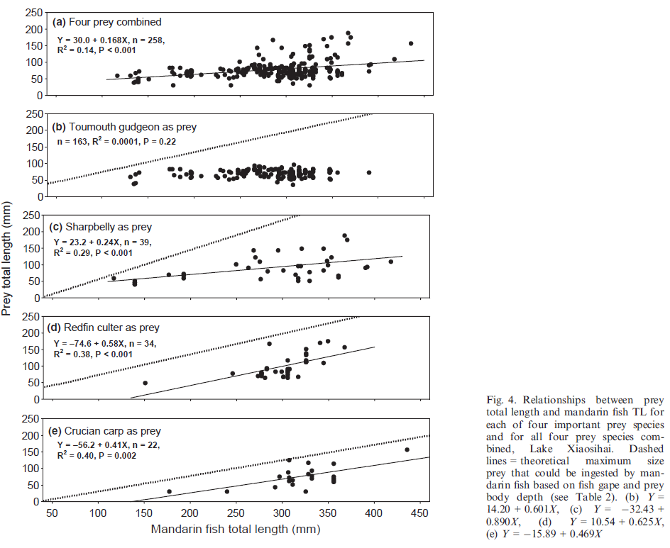
Mandarin fish total length (TL) was strongly related to mouth gape width (GW) and gape height (GH). Mandarin fish TL and prey fish TL as well as mandarin fish GW and prey fish body depth (BD) were positively and linearly related for sharpbelly,redfin culter and crucian carp.
W. Li1,2;T. Zhang1,*;S. Ye1;J. Liu1;Z. Li1 Feeding habits and predator-prey size relationships of mandarin fish Siniperca chuatsi (Basilewsky) in a shallow lake, central China Journal of Applied Ichthyology.2013;29(1):56-63

Slide 9
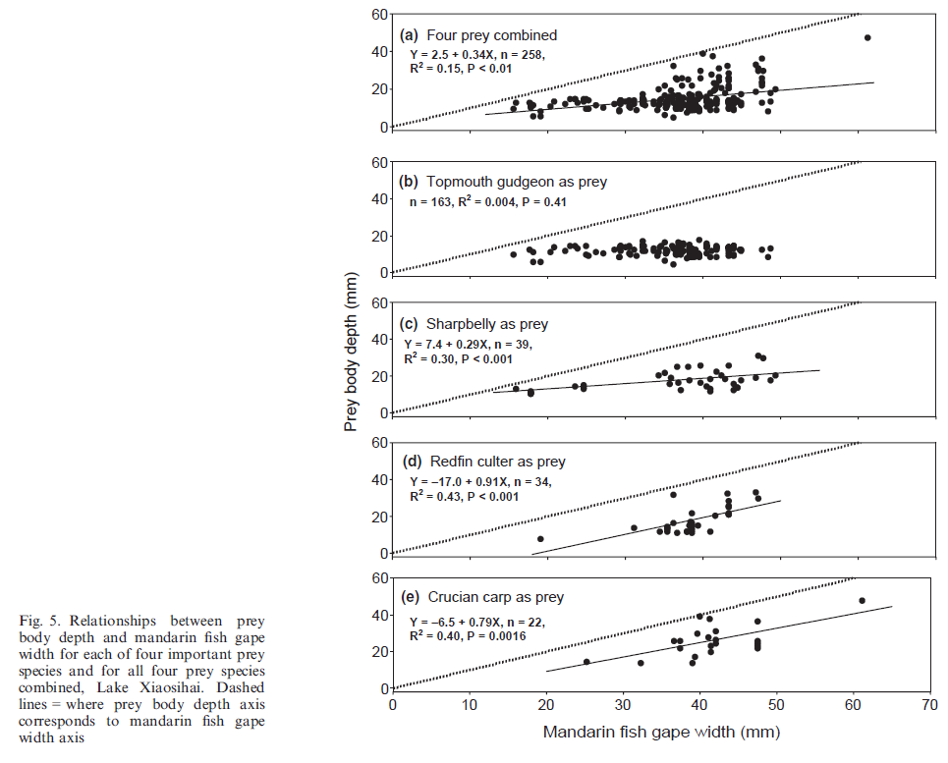
Strong size selectivity for topmouth gudgeon, sharpbelly and redfin culter as prey indicated that the piscivorous mandarin fish can have potential impact on the population size structure of the three prey fish.
W. Li1,2;T. Zhang1,*;S. Ye1;J. Liu1;Z. Li1 Feeding habits and predator-prey size relationships of mandarin fish Siniperca chuatsi (Basilewsky) in a shallow lake, central China Journal of Applied Ichthyology.2013;29(1):56-63

Slide 10
Thanks for watching.

